Slide 1
18 Rotor Heavy Lift Drone Copter Components

Slide 2
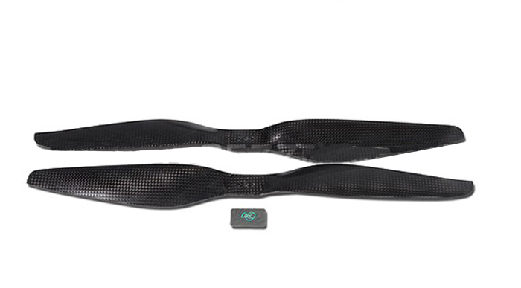
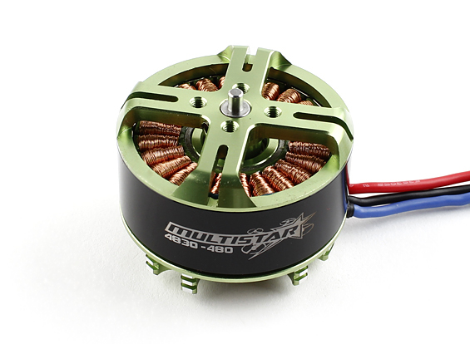
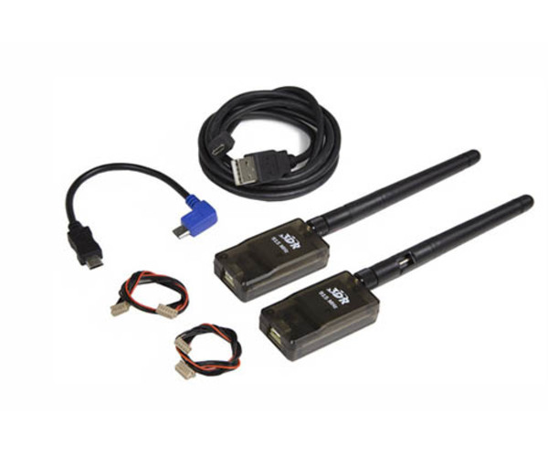
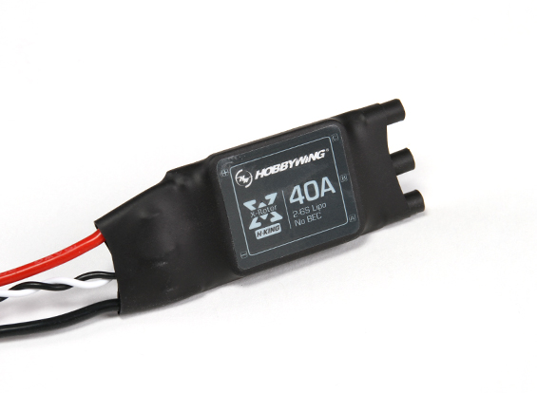
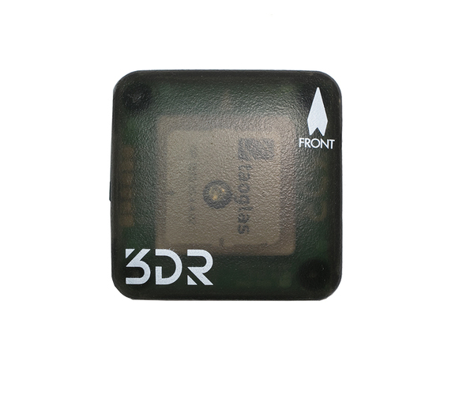
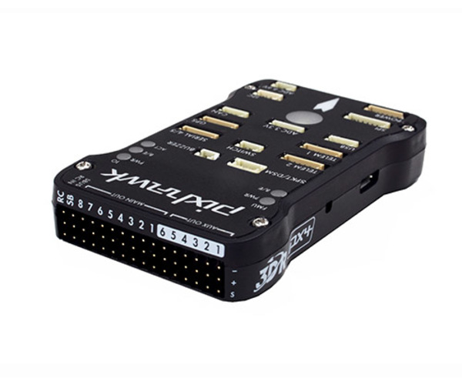
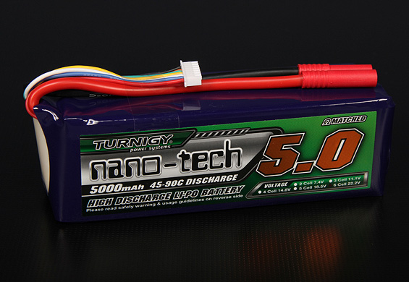
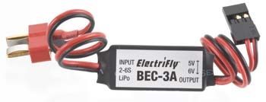
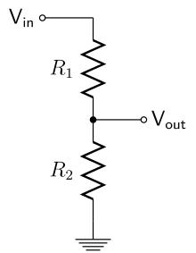
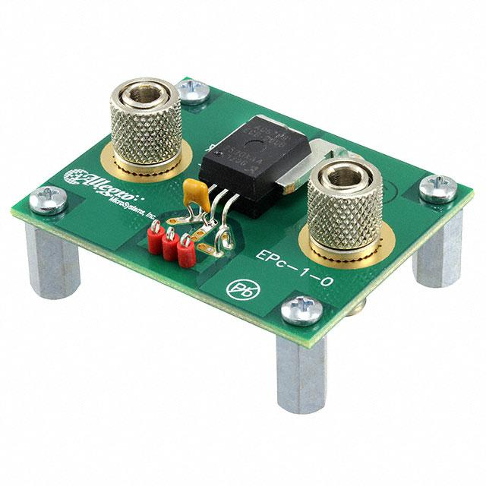
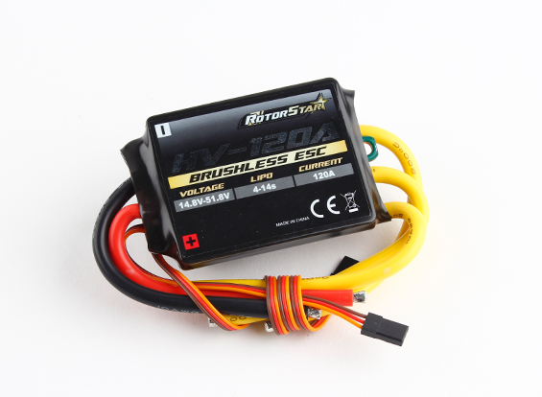
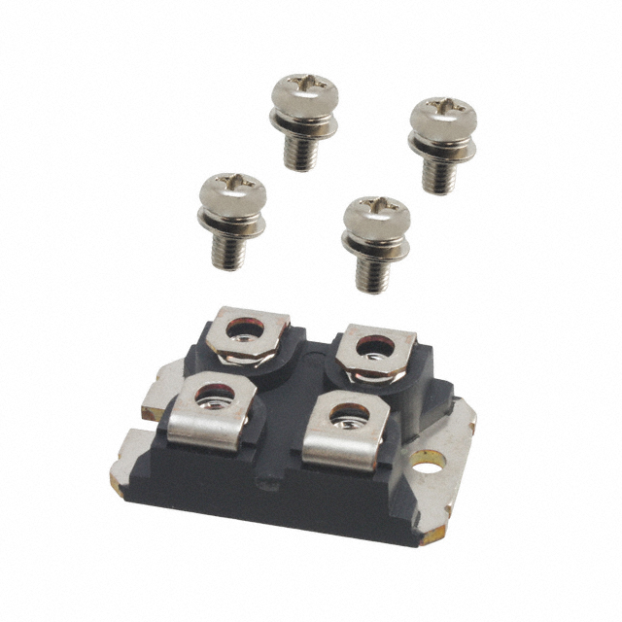
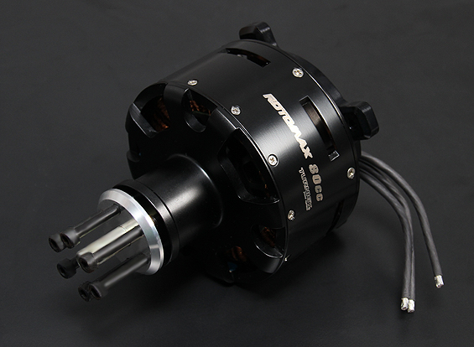
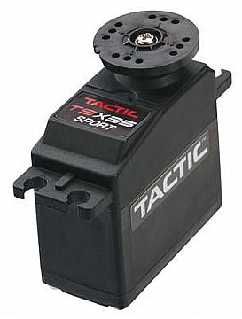
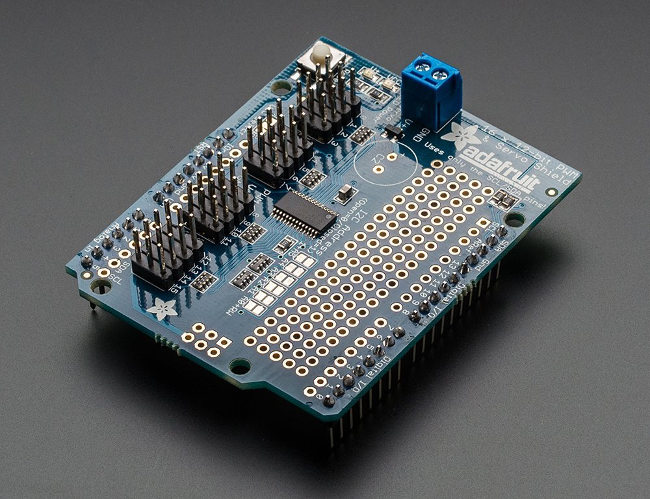
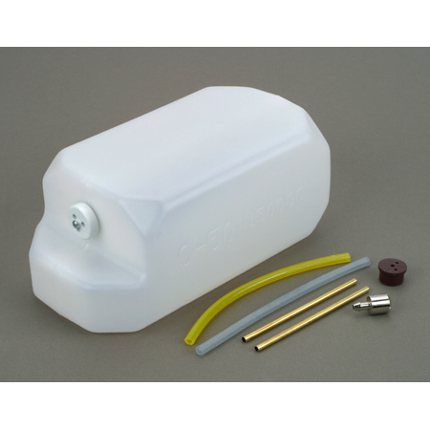
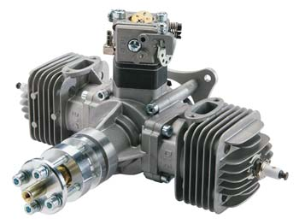
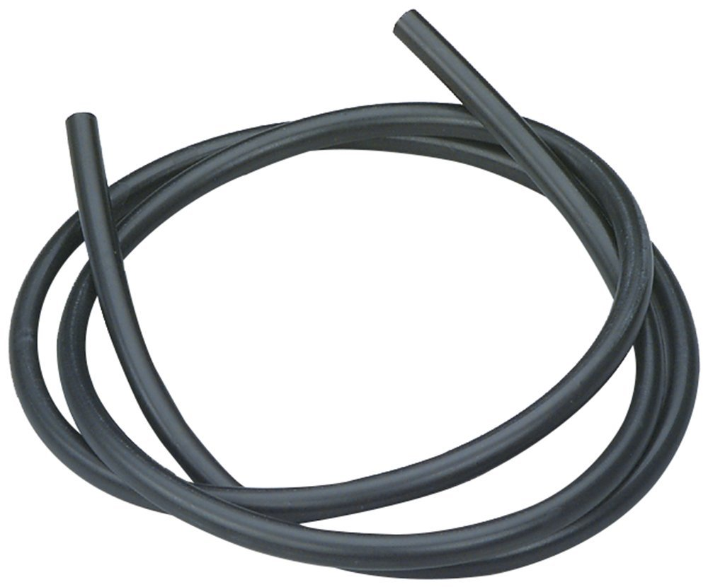
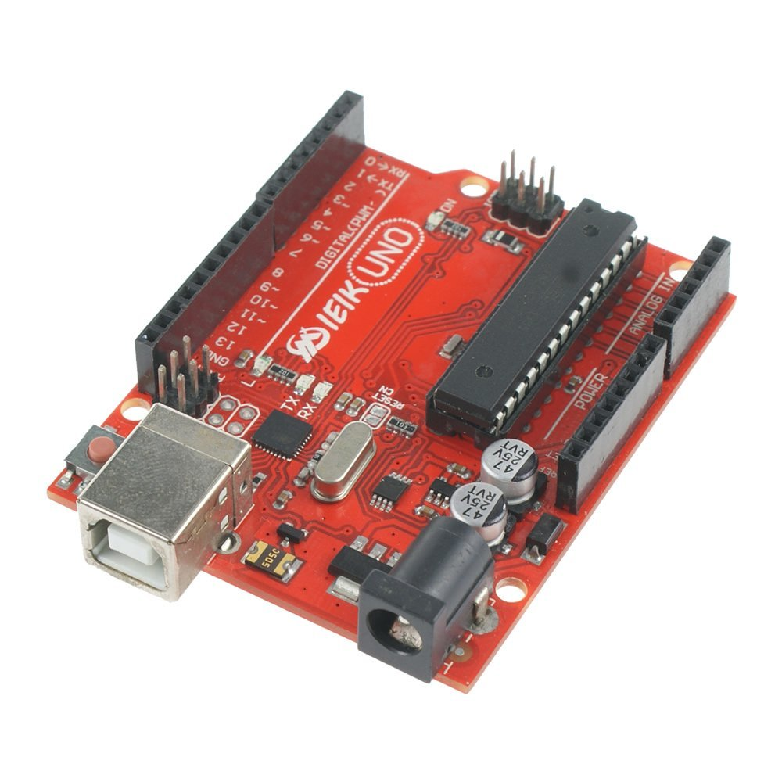
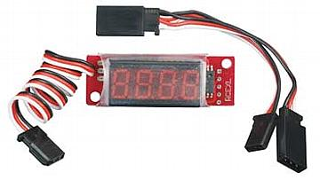

Slide 3
Pixhawk controller
12-10S battery to start engine
Battery Voltage Monitor
Diode
Bridge
Arduino #1 Controls Gas Engine to maintain safe Battery Voltage

Slide 4
DLE 60cc Twin Cylinder Gasoline Engine
https://www.hobbyzone.com/engines/airplane/gas/DLEG0060.html
http://www3.towerhobbies.com/cgi-bin/wti0001p?&I=LXCPZB&P=Z#technotes
Notes:
This is the DLE 60cc Twin Cylinder Gasoline Engine.
FEATURES; Horizontally opposed twin cylinders for low vibration operation
Aluminum alloy crankcase
Electronic ignition for simpler starts, higher performance and
minimal RF noise
Two year limited warranty through Hobby Services beginning at date
of purchase
Includes
DLE 60cc Engine
Electronic ignition
NGK CM6 Spark plug
Two Pitts style mufflers
Engine stand-offs
Requires
Gasoline with at least 87 octane rating
2-cycle oil, mix ratio for this engine is 30 parts gas to one part
oil and must be followed exactly for warranty consideration
and optimum performance
4.8 - 12V battery for ignition
(separate receiver style pack can be used) (LiPo & LiFe requires
voltage regulator)
Propeller: 22x10, 23x8, 23x10, 24x8
Field equipment
Specifications
Displacement*: 61 cc (3.7 cu in)
Bore*: 1.42 in (36 mm)
Stroke: 1.18 in (30 mm)
Weight, engine: 4.37 lb (1.56 kg)
Weight, muffler: 2.82 oz./ 3.00 oz./(80 g/85 g)
Weight, ignition module: 7.44 oz. (211 g)
Output: 5.5 hp @ 8,500 RPM
Static Thrust: 15.2kg Pulling Force/100 meters altitude
13.5kg Pulling Force/1,800 meters altitude
Gasoline/Oil Mixture: 30:1
Gasoline Octane Rating: 87
Recommended Propellers: 22x10, 23x8, 23x10, 24x8
Carburetor Adjustments;
Low Speed Needle: 1.5 turns out as a starting point, adjust for a
smooth idle and a reliable transition to high throttle
High Speed Needle: 1.5 turns out from closed, adjust needle to peak
RPM, if engine slows or dies at full throttle, the high-speed
mixture is likely too lean
Muffler Length: 5" (128mm)
Muffler Diameter: 2" (50mm)
Exhaust Outlet Length: 3.4" (85.5mm)
Exhaust Outlet Diameter: 0.79" (20mm)
Distance Between Mounting Hole Centers Same Side: 2.7" (69mm)
Distance Between Mounting Hole Centers Opposite Side: 2.7" (69mm)
Width from Cylinder Head to Cylinder Head: 8.5" (215mm)

Slide 5
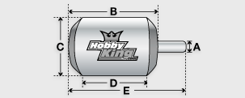
RotoMax 80cc Generator
http://www.hobbyking.com/hobbyking/store/__25410__Turnigy_RotoMax_80cc_Size_Brushless_Outrunner_Motor.html
Notes:
Spec.
Battery: 12 Cell ~ 14 Cell / 44.4V ~ 51.8V
RPM: 195kv
Max current: 150A
Watts: 6600w
No load current: 44V/4.8A
Internal resistance: 0.013 ohm
Weight: 1916g
Diameter of shaft: 10mm
Winding: 8T
Stator Pole: 24
Motor Pole: 20
Stator Diameter: 101
Lamination Tickness: 0.2mm
Suggested ESC: 200A 14S Compatible

Slide 6
55-25 Onboard Digital Tachometer
https://www.hobbyzone.com/dleg5525.html?gclid=Cj0KEQjwvdSvBRDahavi3KPGrvUBEiQATZ9v0AAbzqthp5RqByNOc2UtUVtQ8jEyRAaIWw5XH0h-dY0aAulZ8P8HAQ
Notes:
This is the Onboard Digital Tachometer for use with the DLE 55-25 Engines.
Features
Mini tachometer indicates up to 30,000RPM
Uses high-brightness LED digital tube
Standard Futaba plug
Includes
One Onboard Digital Tachometer
One Y-harness
Requires
Installation between the HALL sensor and the ignition
Specifications
Input Voltage Range: 3.5-8.4V
Current Consumption: 25mA-60mA
Body Size: 41mm x 17mm x 12mm (1.6"x0.67"x0.47")
Window Size: 30mm x 15mm (1.2" x 0.59")
Weight: 8.5g (0.3oz)

Slide 7
Fuel Tank, 50 oz
https://www.hobbyzone.com/building-supplies/hardware/fuel-tanks-related/fuel-tanks/DUB692.html
Notes:
50 oz tank measurements: 3.5" H x 4.375" W x 8.375 Long. Items #690-692 come complete with stopper and fuel tubing for both gas and glo fuel and proportionally larger brass tubing and clunk. Du-Bro Fuel Tanks are designed to be tough! Our fuel tanks will not split or crack from vibration or pressure. In fact, our fuel tanks can be used with pressurized fuel systems!

Slide 8
BEC 3A for 2S-6S LiPo Batteries
https://www.hobbyzone.com/great-planes/all/GPMM1920.html
Notes:
This is the ElectriFly 3A BEC for 2S - 6S LiPo Batteries.
Features
Designed to power the receiver in a model airplane in two different
configurations-
Primary intended use is as a 3 amp voltage regulator by plugging the
receiver LiPo battery into the Deans connector on the BEC and then
into the battery channel on receiver
Can also be used in a three-way connection with the ESC/LiPo to
eliminate the need to add a battery for the receiver, Parallel
Deans Connector required (GPMM3141)
5V or 6V selector allows use of smaller servos limited to 5V
180 day limited warranty, USA and Canada only
Includes
ElectriFly 3A BEC (battery eliminator circuit) for 2S-6S LiPo
Batteries, universal receiver connector, Deans Male Ultra input
connector and instructions
Requires
Connecting between receiver and battery following instruction sheet
Specifications
Battery Type: 2 - 6S LiPo (7.4V - 22.2V)
6 - 18C NiMH/NiCd (7.2V - 21.6V)
Max Constant Current: 3 amps
Selectable Output Voltage: 5 - 6V
Weight: 0.28oz (8g)

Slide 9
TSX35 Standard Servo Sport
https://www.hobbyzone.com/radio-related/servo-related/servos/standard/TACM0235.html
Notes:
This is the Tactic TSX35 Standard Sport Servo.
Features
Ideal servo for throttle control on glow engines, and other
applications that do not require a lot of speed and torque
Universal receiver connector compatible with all major brands of
radio systems
One year limited warranty through Hobby Services beginning at date of
purchase
Includes
Tactic TSX35 Standard Sport Servo
1.4" (35mm) diameter Round Horn
1.5" (38mm) 4-Point Horn
1.2" (31.9mm) 6-point horn
1.8" (45mm) Double Arm Horn
Four each, rubber Grommets, Eyelets, and 2.3 x 14mm Mounting Screws
Specifications
4.8V 6.0V
Torque: 68 oz-in (4.9 kg-cm) 73 oz-in (5.3 kg-cm)
Speed: 0.18 sec/60° 0.16 sec/60°
Dimensions: 1.6 x 0.8 x1.4" (40 x 20 x 37mm)
Weight: 1.3 oz (38 g)

Slide 10
Schottky Diode with SOT227 package
http://www.digikey.com/catalog/en/partgroup/dss-series/14185
Notes:
http://www.gptechgroup.com/pdf/GSXD120A010S1-D3.pdf

Slide 11
ACS759 - Current Sensor Sensor Evaluation Board
http://www.digikey.com/product-detail/en/allegro-microsystems-llc/ASEK759ECB-200B-T-DK/620-1611-ND/
Notes:
http://www.gptechgroup.com/pdf/GSXD120A010S1-D3.pdf

Slide 12
Turnigy nano-tech 5000mah 6S 45~90C Lipo Pack
http://www.hobbyking.com/hobbyking/store/__14616__Turnigy_nano_tech_5000mah_6S_45_90C_Lipo_Pack.html
Notes:
Spec.
Capacity: 5000mAh
Voltage: 6S1P / 6 Cell / 22.2V
Discharge: 45C Constant / 90C Burst
Weight: 813g (including wire, plug & case)
Dimensions: 157x49x50mm
Balance Plug: JST-XH
Discharge Plug: 4mm bullet-connector
Suited to the following models:
6S: MIKADO LOGO500, ALIGN T-REX550/600, GAUI X5, Outrage 550, Hirobo SDX
6S x 2: MIKADO LOGO600SE, HENSELEIT TDR, RJX X-TREME90EP, Rave 90 ENV FBL, Avant eAurora90, JR Airskipper E12, Kasama Srimok 90E, HIROBO Shuttle Plus+2, HIROBO Eagle3 EP, JR Vibe 90SG E12, Joker 3
Advantages over traditional Lipoly batteries;
• Power density reaches 7.5 kw/kg.
• Less Voltage sag during high rate discharge, giving more power under load.
• Internal impedance can reach as low as 1.2mO compared to that of 3mO of a standard Lipoly.
• Greater thermal control, pack usually doesn’t exceed 60degC
• Swelling during heavy load doesn’t exceed 5%, compared to 15% of a normal Lipoly.
• Higher capacity during heavy discharge. More than 90% at 100% C rate.
• Fast charge capable, up to 15C on some batteries.
• Longer Cycle Life, almost double that of standard lipoly technology.
The nano-core technology in lithium ion batteries is the application of nanometer conductive additives. The nanometer conductive additives form ultra-strong electron-conducting networks in the electrodes which can increase electronic conductivity.
These additives create the ability for imbibition in the carrier liquid to supply more ion channels. This improves the ability of ion transmission and ion diffusion. Through improving electronic conductivity and ion transmission, the impedance is reduced and the polarization of high rate discharge decreases greatly.

Slide 13
RotorStar 120A HV (4~14S) Brushless Speed Controller (OPTO)
http://www.hobbyking.com/hobbyking/store/__55384__RotorStar_120A_HV_4_14S_Brushless_Speed_Controller_OPTO_.html
Notes:
Features:
• HV capability for use with up to 14S (51.8V) Lipoly
• Optional programming card for convenient setup
• ESC had separate programming lead built-in so there is no need to unplug from RX
• Super fine throttle resolution provides first-rate and highly accurate linearity
• Super smooth adjustable start-up mode
• Constant RPM mode (governor mode)
• Adjustable F3A brake.
• 3 steps adjustable normal EMF brake
• High anti-interference capability
• Low voltage cut-off protection with automatic adjustment for NiCd/NiMH/Li-Ion/LiPo/LiFePO4
• Soft cut-off option at low voltage, slows motor RPM gradual rather than hard cutoff (LVC)
• Low voltage cut-off can be disabled
• Variable cut-off voltage / cell
• Active free-wheeling circuit allows for unlimited "partial load" capability
• LED status display
• Adjustable motor timing from 0° to 30°
• Blocked rotation protection (senses a jammed motor and stops motor rotation)
• Motor reversing from ESC (no need to change ESC/motor wires)
• Over-temperature protection and overload alarm
• Anti sparking circuit: reduces connection sparks
• Throttle signal lose protection. If the signal is lost for 3 seconds, the power will automatically cut-off.
• Safe power-on. (Motor will not start until throttle is returned to lowest position)
***This ESC is compatible with both helicopter and airplane models.***
Specification:
Max Cont Current: 120A
Max Burst Current: 140A for 10 seconds
Input Voltage: 4-14 cells li-XX or 12-42 Ni-MH/Ni-Cd battery
BEC: None (OPTO)
PWM: 8~16 KHz
Max RPM: 240,000rpm for 2 Poles Brushless Motor
PCB Size: 68x53mm
Weight: 164g (including wires)

Slide 14
Turnigy Multistar 4830-480Kv 22Pole Multi-Rotor Outrunner
http://www.hobbyking.com/hobbyking/store/__26961__Turnigy_Multistar_4830_480Kv_22Pole_Multi_Rotor_Outrunner.html
Notes:
Spec:
KV(RPM/V): 480
Lipo cells: 6s
Max Surge Watts(W): 680
Working current: 22 amps
Max.current(10s): 31 amps
No Load Current: 1.2 amps
Intemal Resistance: 0.062 ohm
Number of Poles: 22
Dimensions(Dia.xL): 47.5 x 33 mm
Shaft: 3 mm
Prop: 14 x 4-15 x 5
Weight: 154g

Slide 15
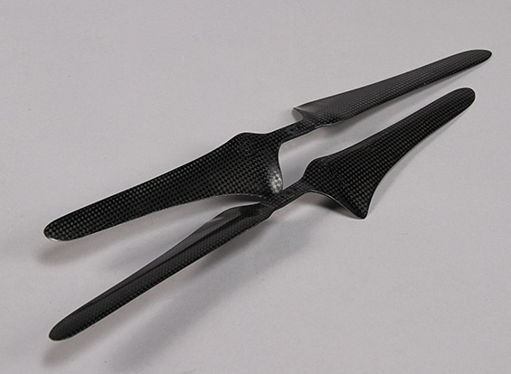
16x5.5 Carbon fiber propellers
http://www.hobbyking.com/hobbyking/store/__39781__16x5_5_Carbon_fiber_propellers_to_suit_the_DJI_S800_Hexacopters_1_pair_of_L_H_and_R_H_rotation_.html
Notes:
Weight is 50 g

Slide 16
Hobbywing X-Rotor ESC - 40amp
http://www.hobbyking.com/hobbyking/store/__73080__Hobbywing_X_Rotor_ESC_40amp.html
Notes:
The Hobbywing X-Rotor series ESC are a good quality multirotor speed controller. They have a broad range of programming features combined with a linear throttle curve.
Our Hobbywing X-Rotor series controllers come with a 12 month warranty. These speed controllers are sold in western countries under various names at triple the price. We are certain you will find these to be amongst the best BESC available from Asia.
User Programmable, both via controller and optional programming card. The programming card is an excellent item saving you the hassle trying to use your transmitter. It instantly displays current settings and change settings are as easy as a few button clicks
Spec.
Cont Current: 40A
Burst Current: 45A
BEC Mode: No BEC
Lipo Cells: 2-4
NiMH : 5-12
Weight: 13g
Size: 32x24x10mm

Slide 17
Turnigy Multistar 4830-480Kv Replacements?
T-Motor MN4014-KV400
http://www.hobbypartz.com/02p-motor-819-mn4014-kv400.html
Quite similar? Little bigger
Other T-motor types
http://www.rctigermotor.com/html/products/t-motor/Professional/
http://www.rctigermotor.com/html/products/t-motor/Navigator/
T-Motor MN5212
Specifications:
KV...................................................................................340
Configu ration..............................................................24N22P
Stator Diameter..............................................................52mm
Stator Length.................................................................12mm
Shaft Diameter.................................................................4mm
Motor Dimensions(Dia.*Len)..................................Φ59×33.5mm
Weight (g)........................................................................205g
ldle current(10)@10v(A)......................................................1.1A
No.of Cells(Lipo)................................................................4-8S
Max Continuous current(A)180S...........................................35A
Max Continuous Power(W)180S.........................................840W
Max. efficiency current............................................(5-12A)>83%
internal resistance.............................................................69mΩ
http://www.rctigermotor.com/html/2015/Navigator_0206/287.html
Bigger motor rated to more power
https://www.amazon.com/T-Motor-High-Performance-Brushless-Electric-Multi-Rotor/dp/B011U0G0XO
Notes:
Spec:
KV(RPM/V): 480
Lipo cells: 6s
Max Surge Watts(W): 680
Working current: 22 amps
Max.current(10s): 31 amps
No Load Current: 1.2 amps
Intemal Resistance: 0.062 ohm
Number of Poles: 22
Dimensions(Dia.xL): 47.5 x 33 mm
Shaft: 3 mm
Prop: 14 x 4-15 x 5
Weight: 154g

Slide 18
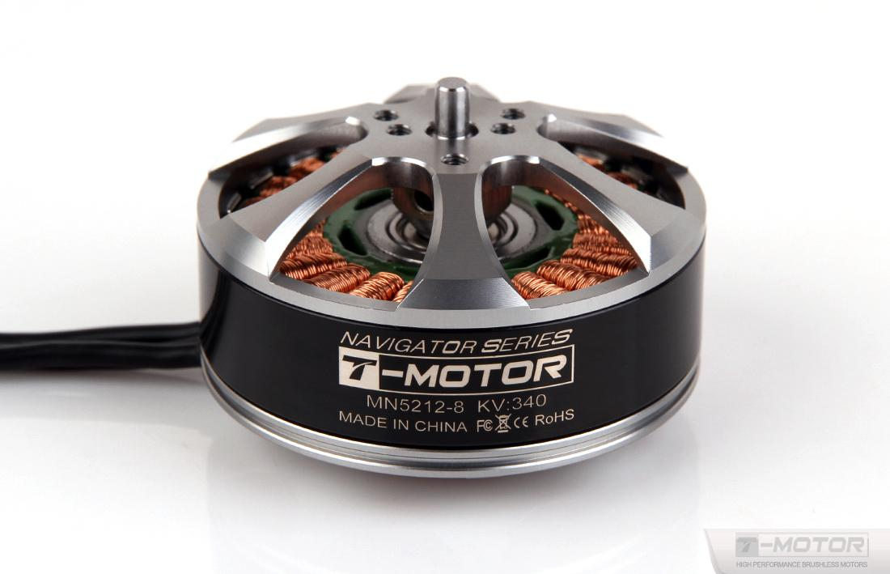
T-Motor MN5212 KV340 Brushless Electric Motor for Multi-Rotor Aircraft
Spec:
Specifications:
KV...................................................................................340
Configu ration..............................................................24N22P
Stator Diameter..............................................................52mm
Stator Length.................................................................12mm
Shaft Diameter.................................................................4mm
Motor Dimensions(Dia.*Len)..................................Φ59×33.5mm
Weight (g)........................................................................205g
ldle current(10)@10v(A)......................................................1.1A
No.of Cells(Lipo)................................................................4-8S
Max Continuous current(A)180S...........................................35A
Max Continuous Power(W)180S.........................................840W
Max. efficiency current............................................(5-12A)>83%
internal resistance.............................................................69mΩ
https://smile.amazon.com/gp/product/B011U0G0XO/ref=od_aui_detailpages00?ie=UTF8&psc=1
http://www.rctigermotor.com/html/2015/Navigator_0206/287.html
Notes:
Spec:
KV(RPM/V): 480
Lipo cells: 6s
Max Surge Watts(W): 680
Working current: 22 amps
Max.current(10s): 31 amps
No Load Current: 1.2 amps
Intemal Resistance: 0.062 ohm
Number of Poles: 22
Dimensions(Dia.xL): 47.5 x 33 mm
Shaft: 3 mm
Prop: 14 x 4-15 x 5
Weight: 154g

Slide 19
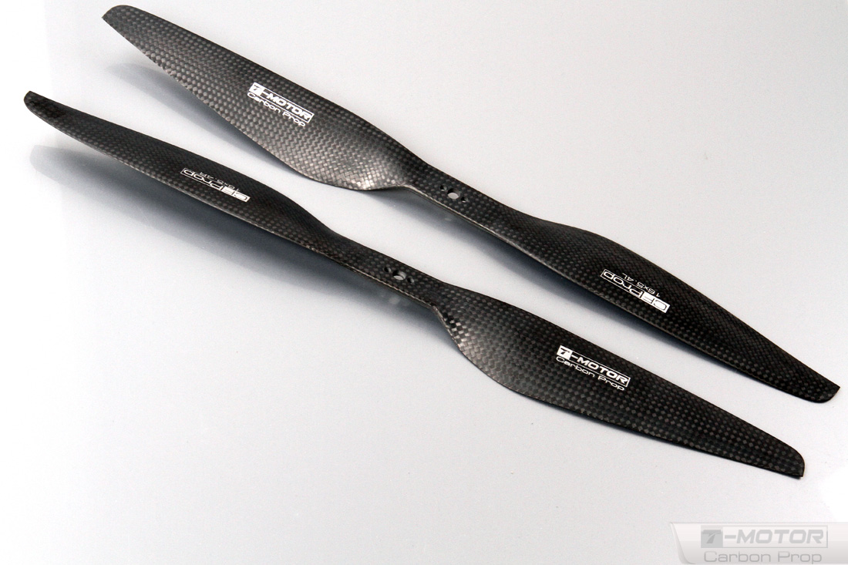
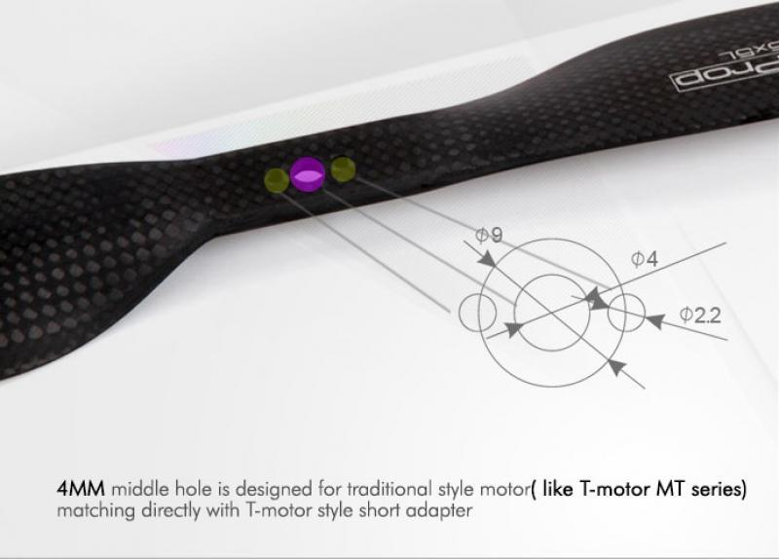
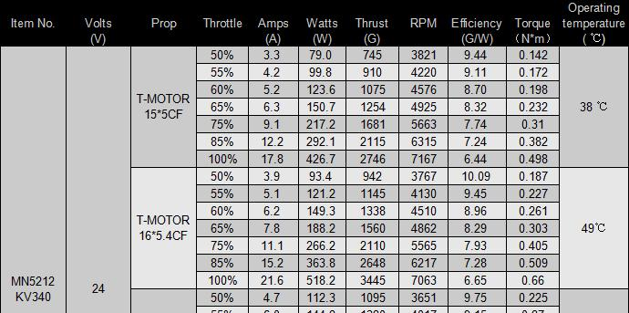
16x5.4 Carbon fiber propellers
http://team-blacksheep.com/products/prod:tmotor_cfprop_16
http://www.rctigermotor.com/html/2013/prop_0904/33.html
Notes:
Weight is 50 g

Slide 20
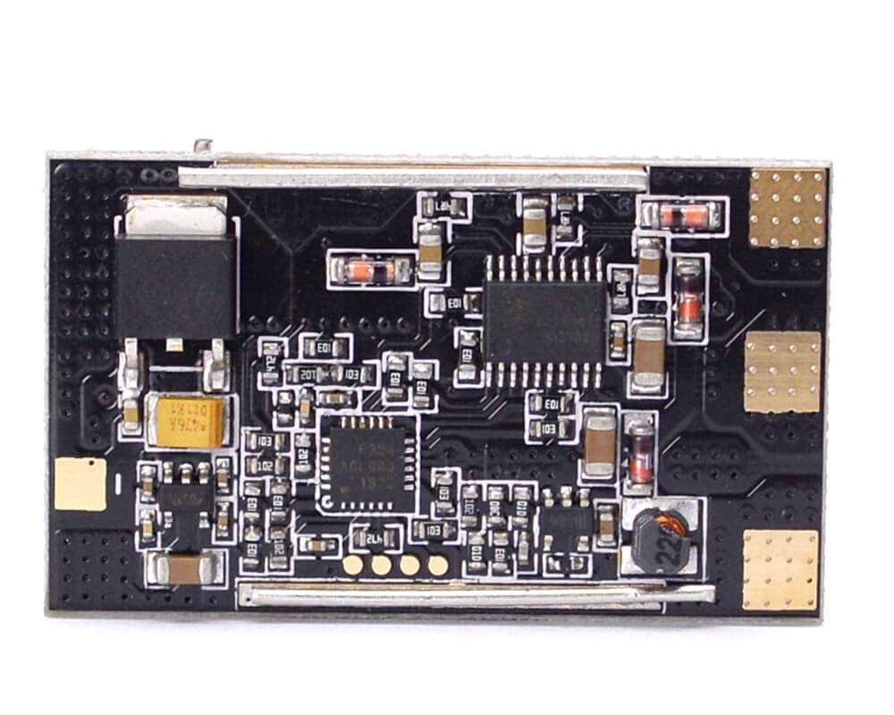
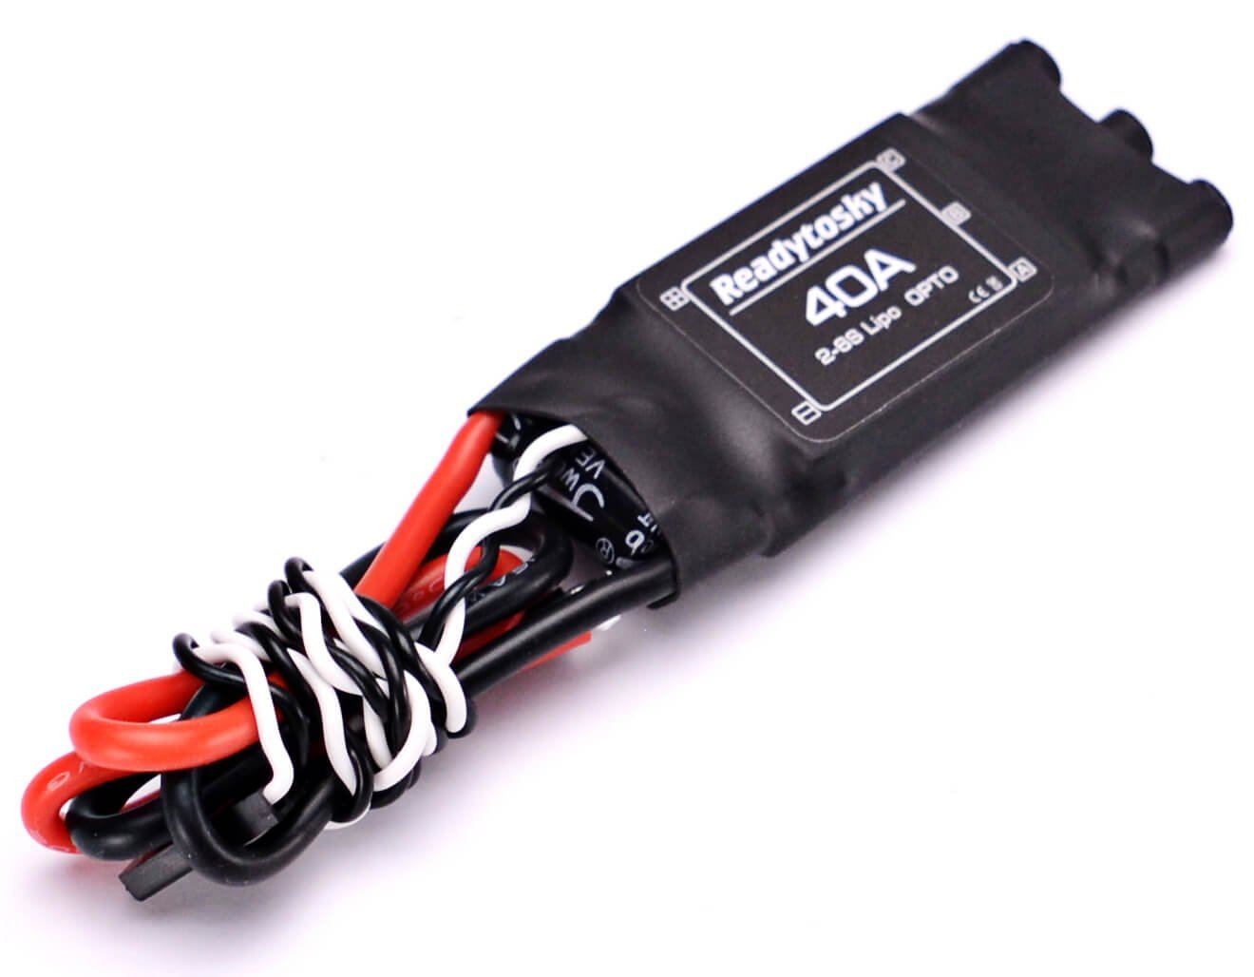
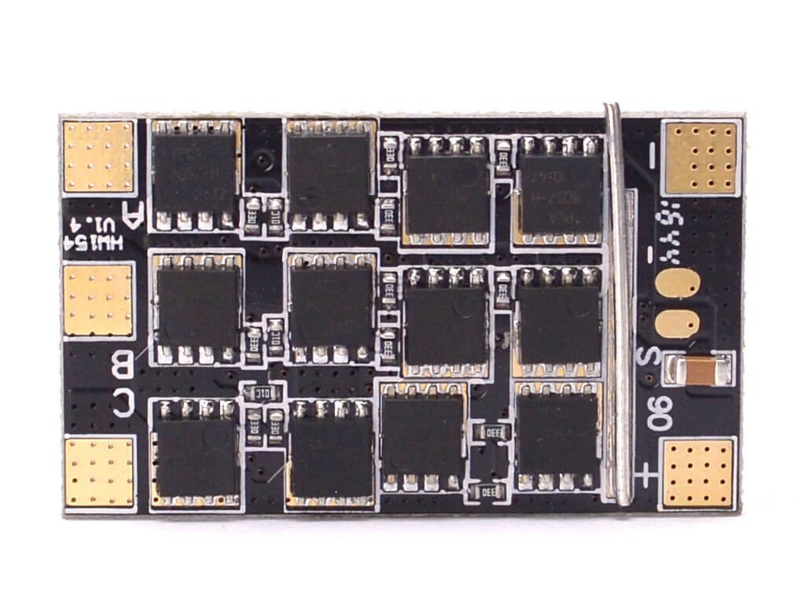
Readytosky 2-6S OPTO 40A ESC
https://smile.amazon.com/gp/product/B01MSSY1DH/ref=oh_aui_detailpage_o00_s00?ie=UTF8&psc=1
Notes:
The Hobbywing X-Rotor series ESC are a good quality multirotor speed controller. They have a broad range of programming features combined with a linear throttle curve.
Our Hobbywing X-Rotor series controllers come with a 12 month warranty. These speed controllers are sold in western countries under various names at triple the price. We are certain you will find these to be amongst the best BESC available from Asia.
User Programmable, both via controller and optional programming card. The programming card is an excellent item saving you the hassle trying to use your transmitter. It instantly displays current settings and change settings are as easy as a few button clicks
Spec.
Cont Current: 40A
Burst Current: 45A
BEC Mode: No BEC
Lipo Cells: 2-4
NiMH : 5-12
Weight: 13g
Size: 32x24x10mm

Slide 21
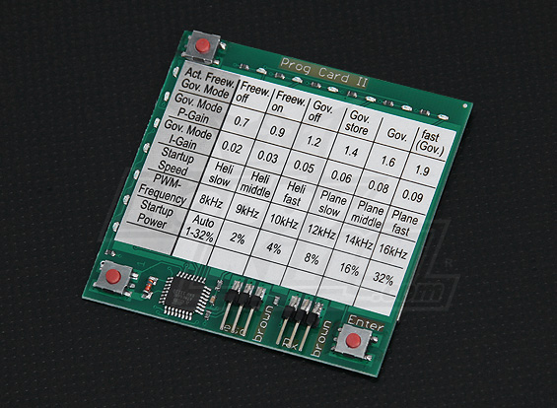
Hobbyking YEP ESC Programming Card
http://www.hobbyking.com/hobbyking/store/__20698__Hobbyking_YEP_ESC_Programming_Card.html
Notes:
Programming Options:
• Active free-wheeling circuit mode: Freew. off/Freew. on
• Govenor mode: Gov. off/Gov. store/Gov./fast Gov.
• Govenor mode P-gain: 0.7/0.9/1.2/1.4/1.6/1.9
• Govenor mode I-gain: 0.02/0.03/0.05/0.06/0.08/0.09
• Startup speed: Heli slow/Heli middle/Heli fast/Plane slow/Plane middle/Plane fast
• PWM frequency: 8kHz/9kHz/10kHz/12kHz/14kHz/16kHz
• Start-up power: Auto 1~32%/2%/4%/8%/16%/32%
• Motor timing: 0°/6°/12°/18°/24°/30°
• Brake: off/Acro/Acro hard/smooth/middle/hard
• Cut-off type: off/slow down/cut-off/NiMh/LiFe/LiPo
• Cut-off voltage (LiFe mode): 2.2/2.3/2.4/2.5/2.6/2.7
• Cut-off voltage (LiPo mode): 2.9/3.0/3.1/3.2/3.3/3.4
• Cells: 4/5/6/7/8/9
• Cells: 10/11/12/13/14/15
• Special functions: Beep short/Rev./Stop/Full speed/F3A brake/Auto timing

Slide 22
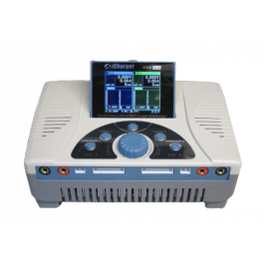
iCharger 4010Duo
http://www.progressiverc.com/icharger-4010duo.html

